Slide 1
Why I choose video game store: I wanted to make a place where you can bring your classic Games and trade them towards a next-gen PlayStation game, Xbox game, and Nintendo game, but also a place where everyone could meet up on weekends, after work, or on their lunch break and play their games.
Title: TheGamingZone

Slide 2
Home
Services
Location
Store Lounge
Buy, Sell, Trade

Slide 3
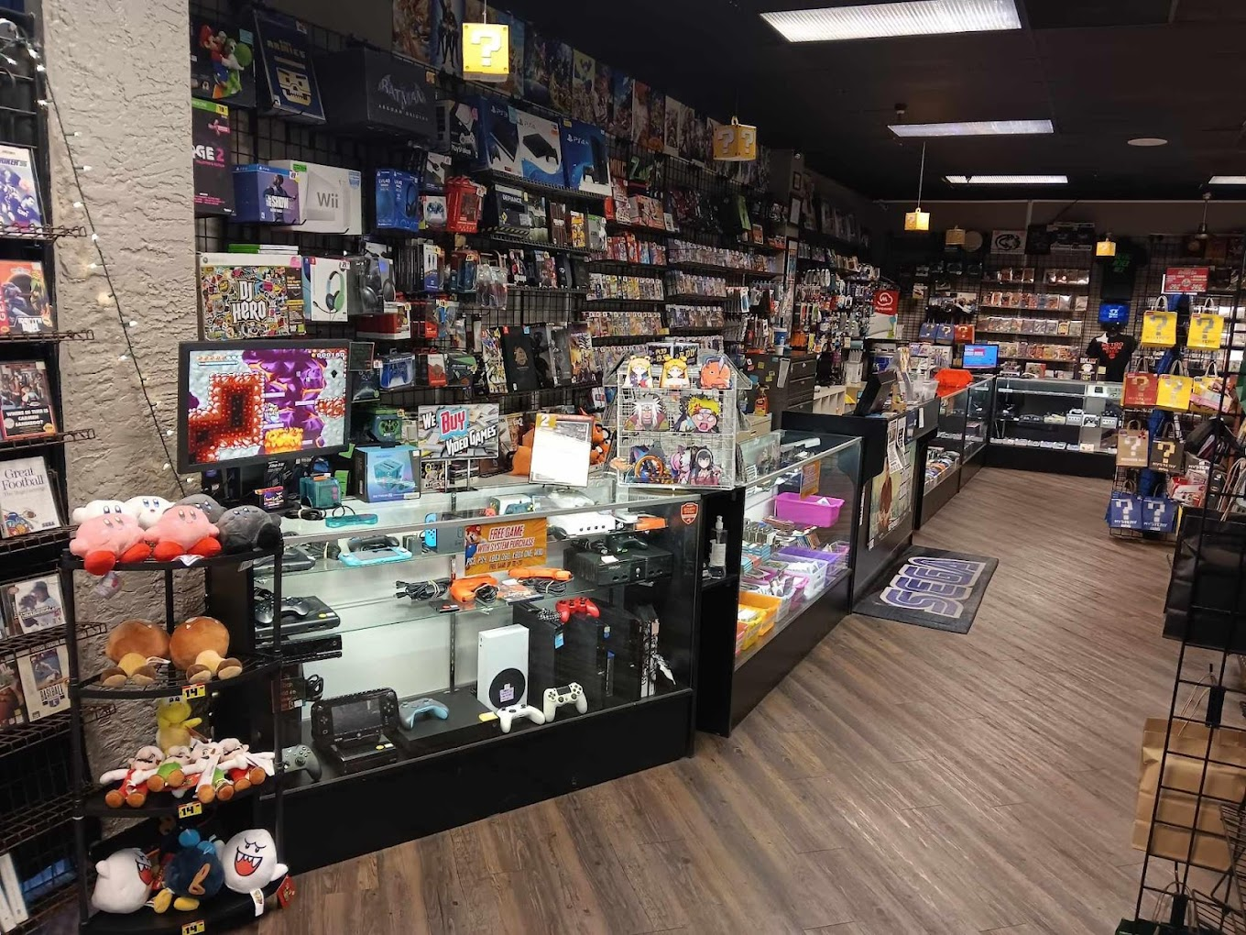

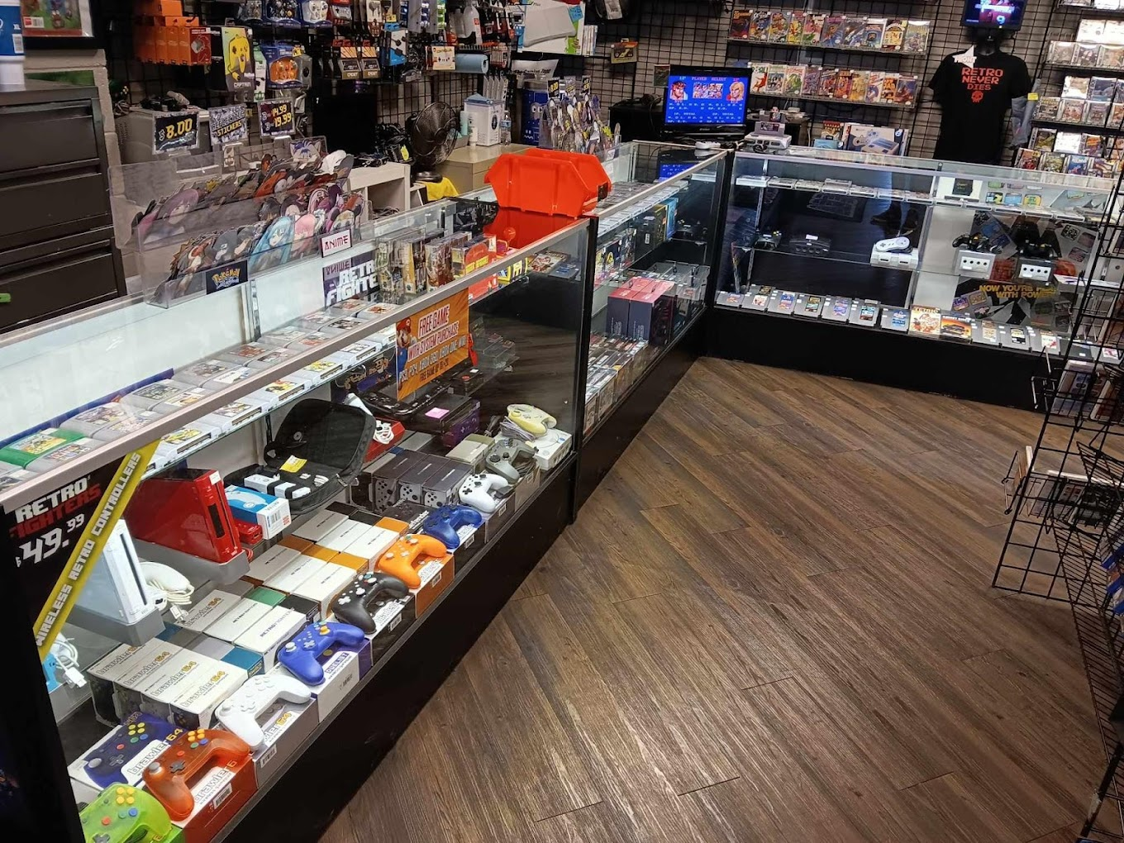
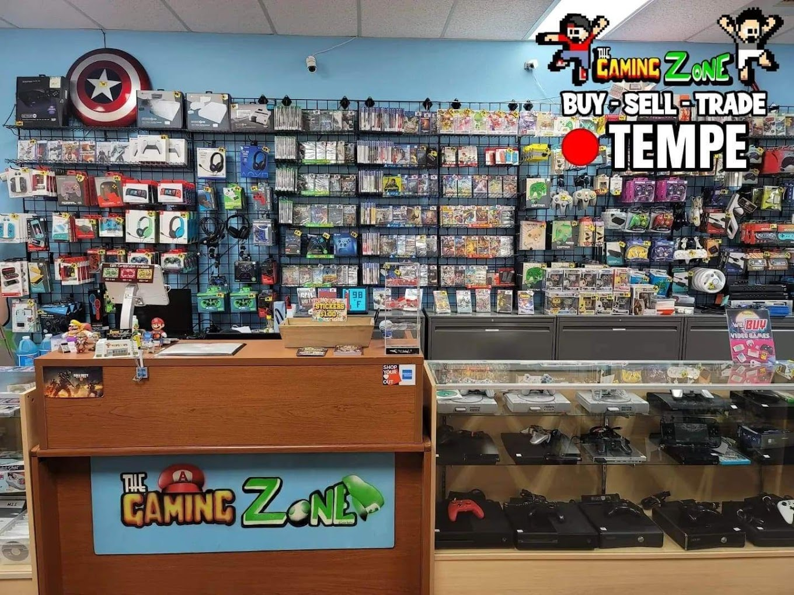
Nav Bar
Need help choosing a console system or Video Game?
When choosing a gaming console, it is important to consider factors such as price, game selection, and performance. Each console has its own strengths and weaknesses, so it is important to do your research.
What to buy pre-Owned console system or video game?
pre-owned items available for purchase every day. We receive new, pre-owned console system & video games daily so be sure to check our inventory frequently as the pre-owned game selection is always changing.
Footer
copy rights & Email

Slide 4
Nav Bar
Services
Our store services game consoles new & pre-owned, video games new & pre-owned, retro video games.
Shipping form & table
Footer
copy rights & Email

Slide 5
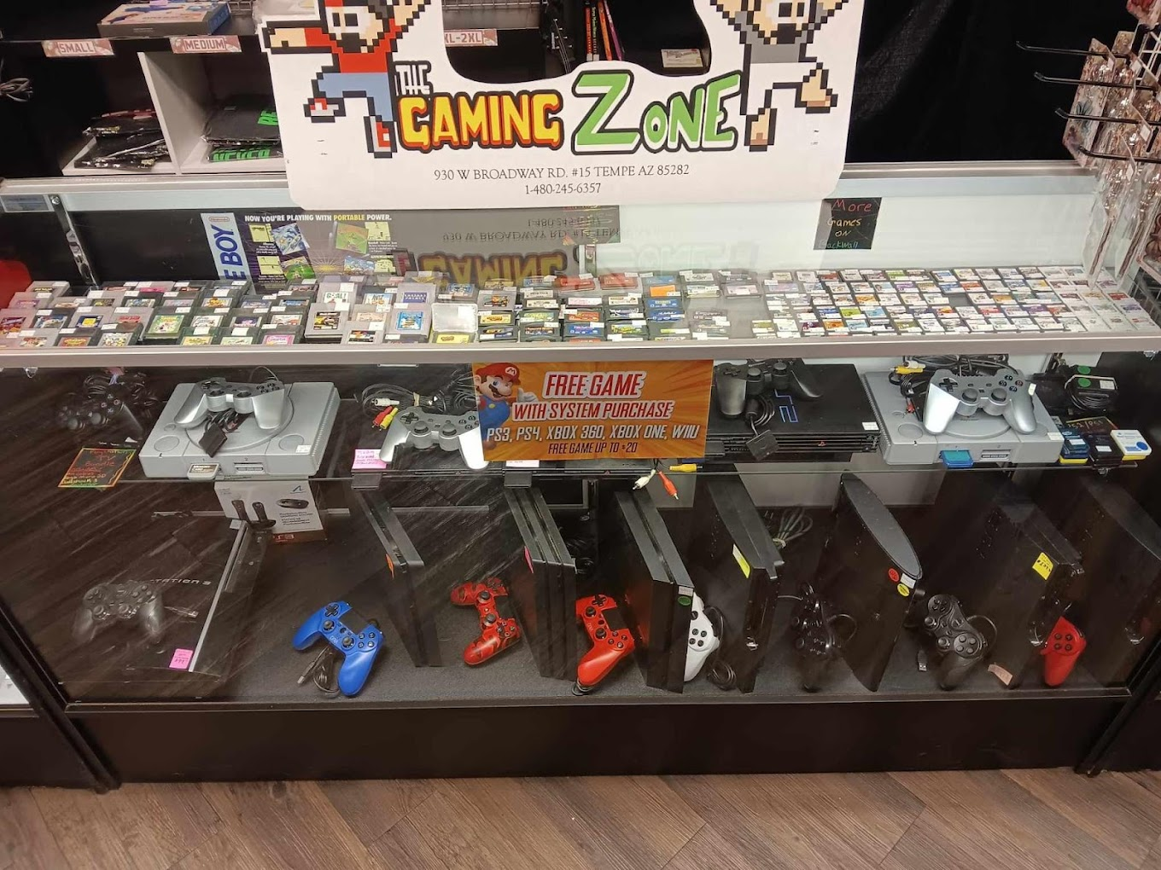
Nav Bar
Buy, Sell, Trade Video Games & Gear!
Do you have old, unplayed, or completed games and gear just laying around that you are looking to sell or trade? It is easy to turn them into something useful! Whether that's video games, gear, or simply cash. Here's a sample of what comes in our doors on a daily basis.
List of games & consoles
Footer
copy rights & Email

Slide 6
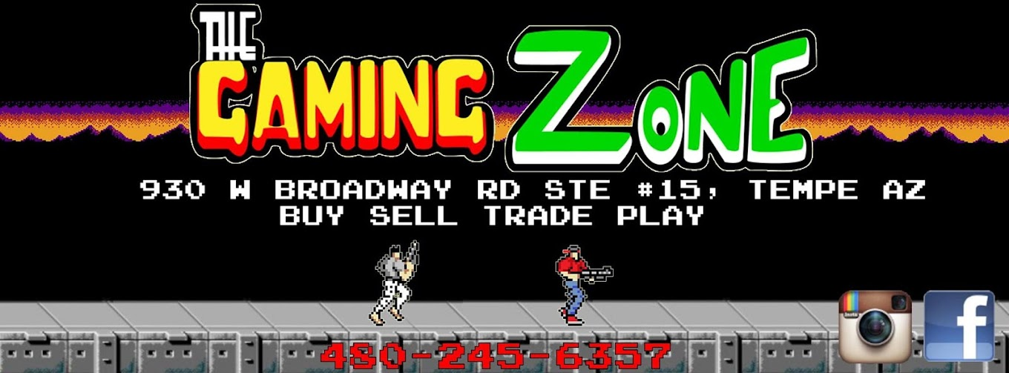
Nav Bar
Location & Shipping
Map/ Iframe
Footer
copy rights & Email

Slide 7
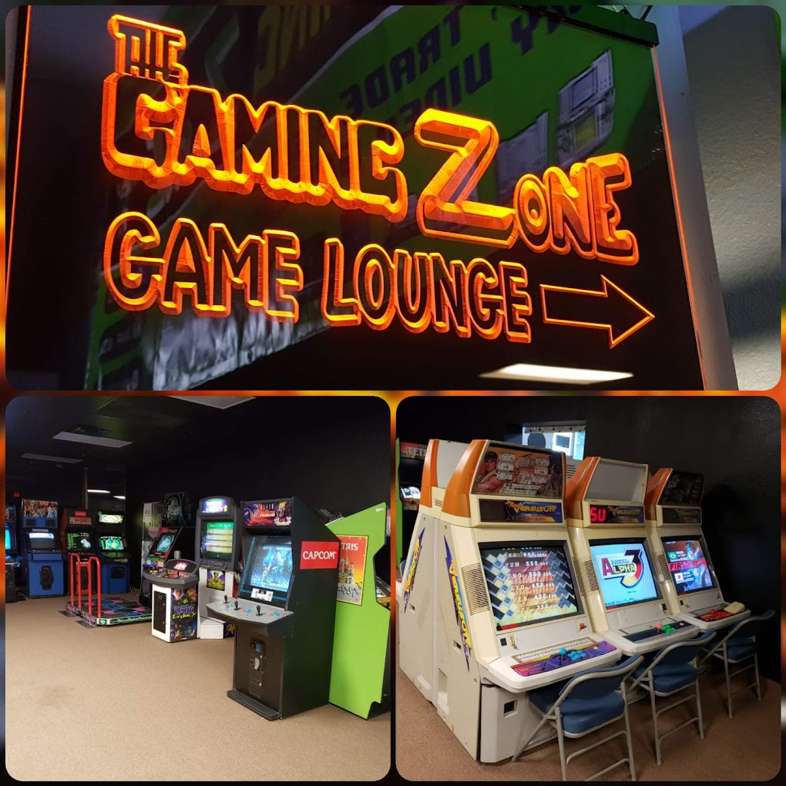
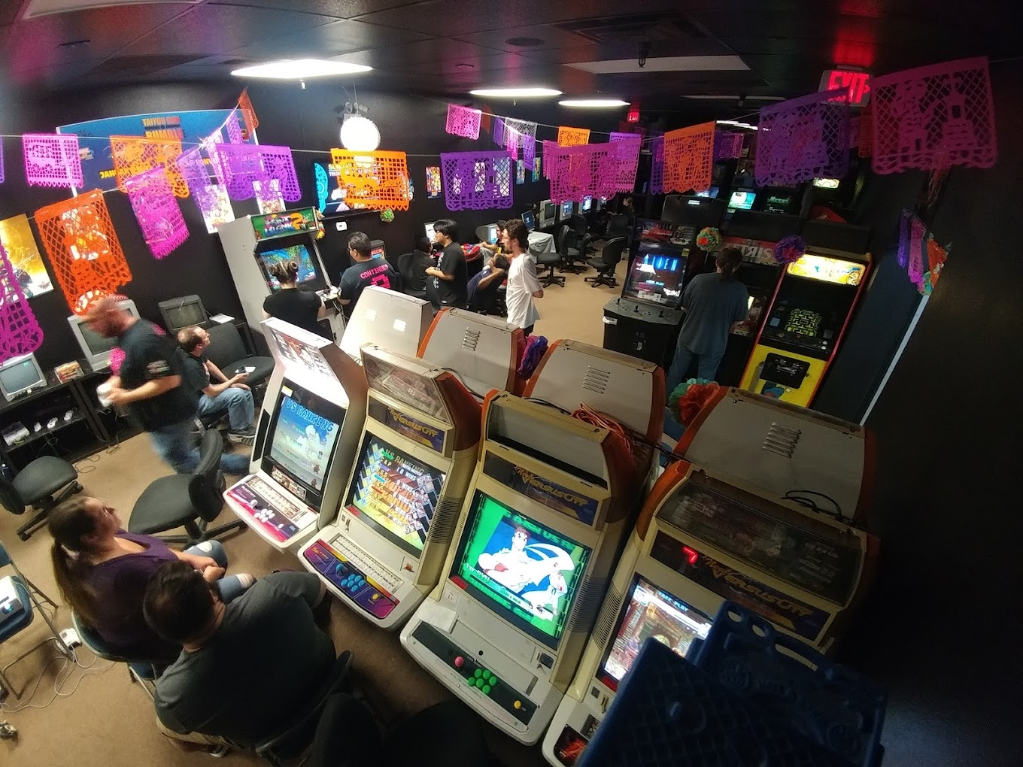
Nav Bar
Store Lounge
We have opened our lounge to all gamers, young and old, and invite them to bring their consoles, games, or just themselves, for a night of all things retro-gaming. Come check out our arcade room.
Footer
copy rights & Email

